Slide 1
Replicability and data/algorithm storage and availability
3rd Workshop on Replication in Extended Reality (WoRXR)
Florian Weidner

Slide 2
Outline for the next 15 minutes
Why publish data and algorithms?
What could (should) we store?
Where to store?
Zenodo
OSF
How do we document it?
Summary

Slide 3
Why publish data?
Reproducibility: reanalysing existing data in the same manner. Replicability: reconducting the analysis, including data collection.
Reproducibility and replicability. For example:
Prototype shared: test exactly the same.
Data shared: calculate exactly the same
Everything: do exactly the same.
But also:
Comparison with new findings easier (statistics)
Making improvements is easier (iterations)

Slide 4
What could (should?) we store?
Simulation data
Data from surveys, questionnaires and interviews
Audio-visual data
Software, code, scripts
Measurement data (raw + processed)
Analysis data
...etc.

Slide 5



Where to store?
„Popular“: osf.io, zenodo.org, IEEEDataPort
Some institutions have platforms
Criteria:
Offers DOI
promises long-term storage
Stable funding
(Free)
Notes:
https://evodify.com/free-research-repository/
re3data.org

Slide 6
Zenodo
All about storage.

Slide 7
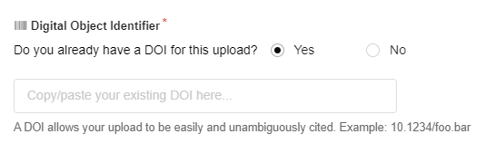
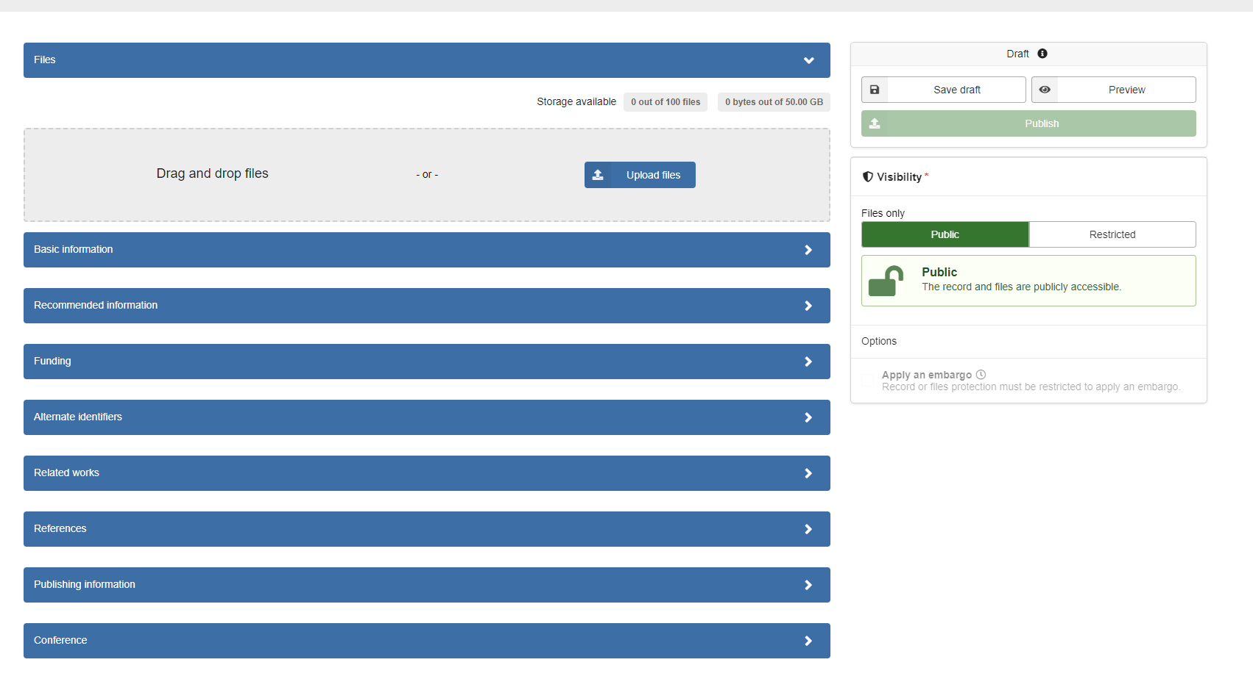
Zenodo UI
Signup / login
Create new upload
Get DOI
Fill in metadata
Upload files
Review
Publish
➔ straightfoward

Slide 8
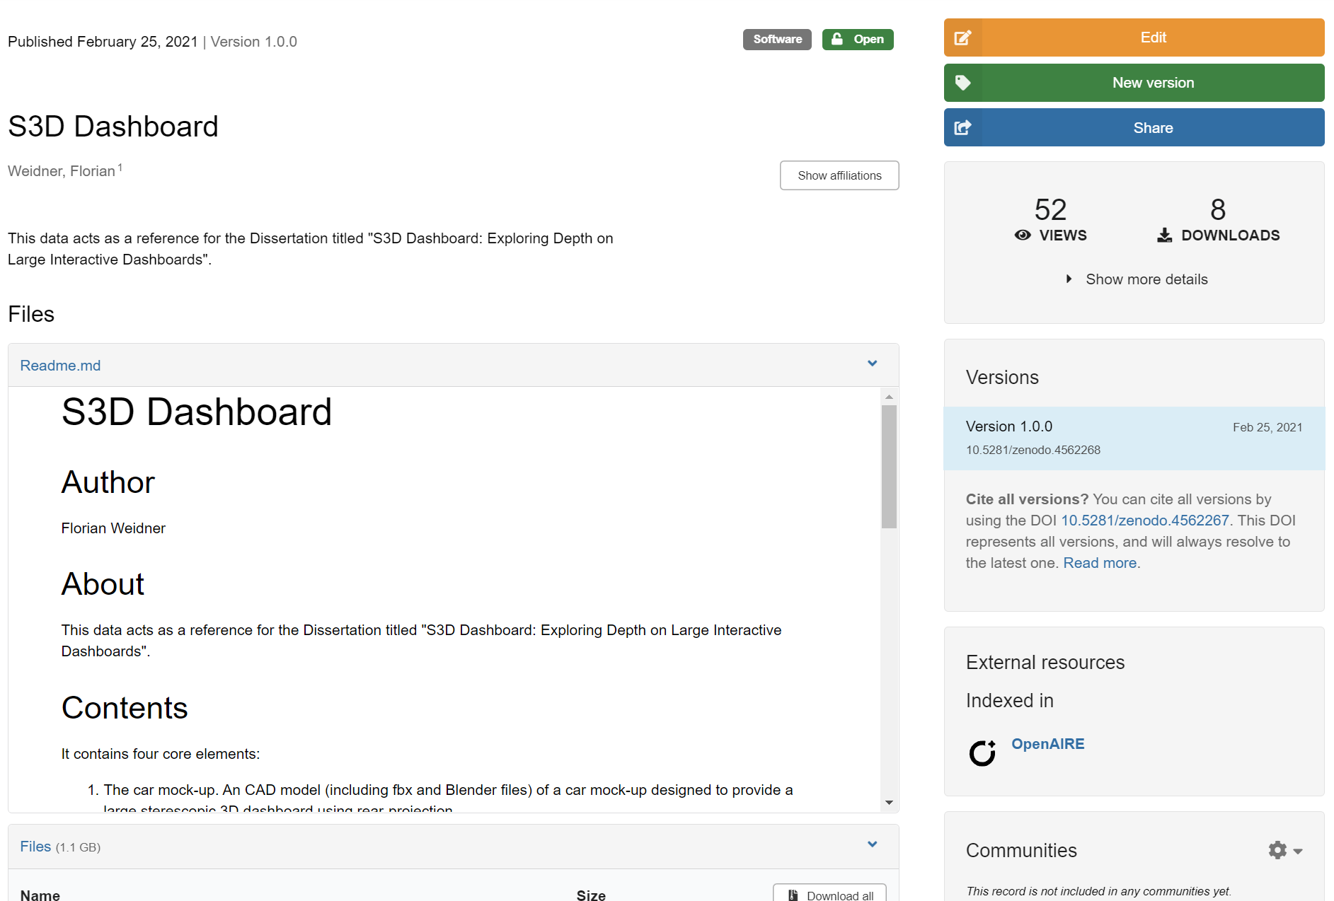
Example

Slide 9
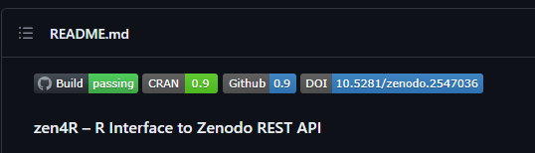
Comments on Zenodo
Free
Funded by CERN (long-term perspective)
No anonymous links; collaborators can be modified
Versioning possible
50GB
Links to github release
auto-update on new release
Nice github Zenodo badge
https://github.com/eblondel/zen4R

Slide 10
OSF (Open Science Framework)
It’s all about (pre-)registration, project, and resources: lifecycle
TIL: “OSF is maintained and developed by the Center For Open Science (COS)”

Slide 11
Registration + Project (+ Preprint)
Registration is the start
Registration creates project
Project is for data and collaboration
Is flexible
Own storage or external
History

Slide 12
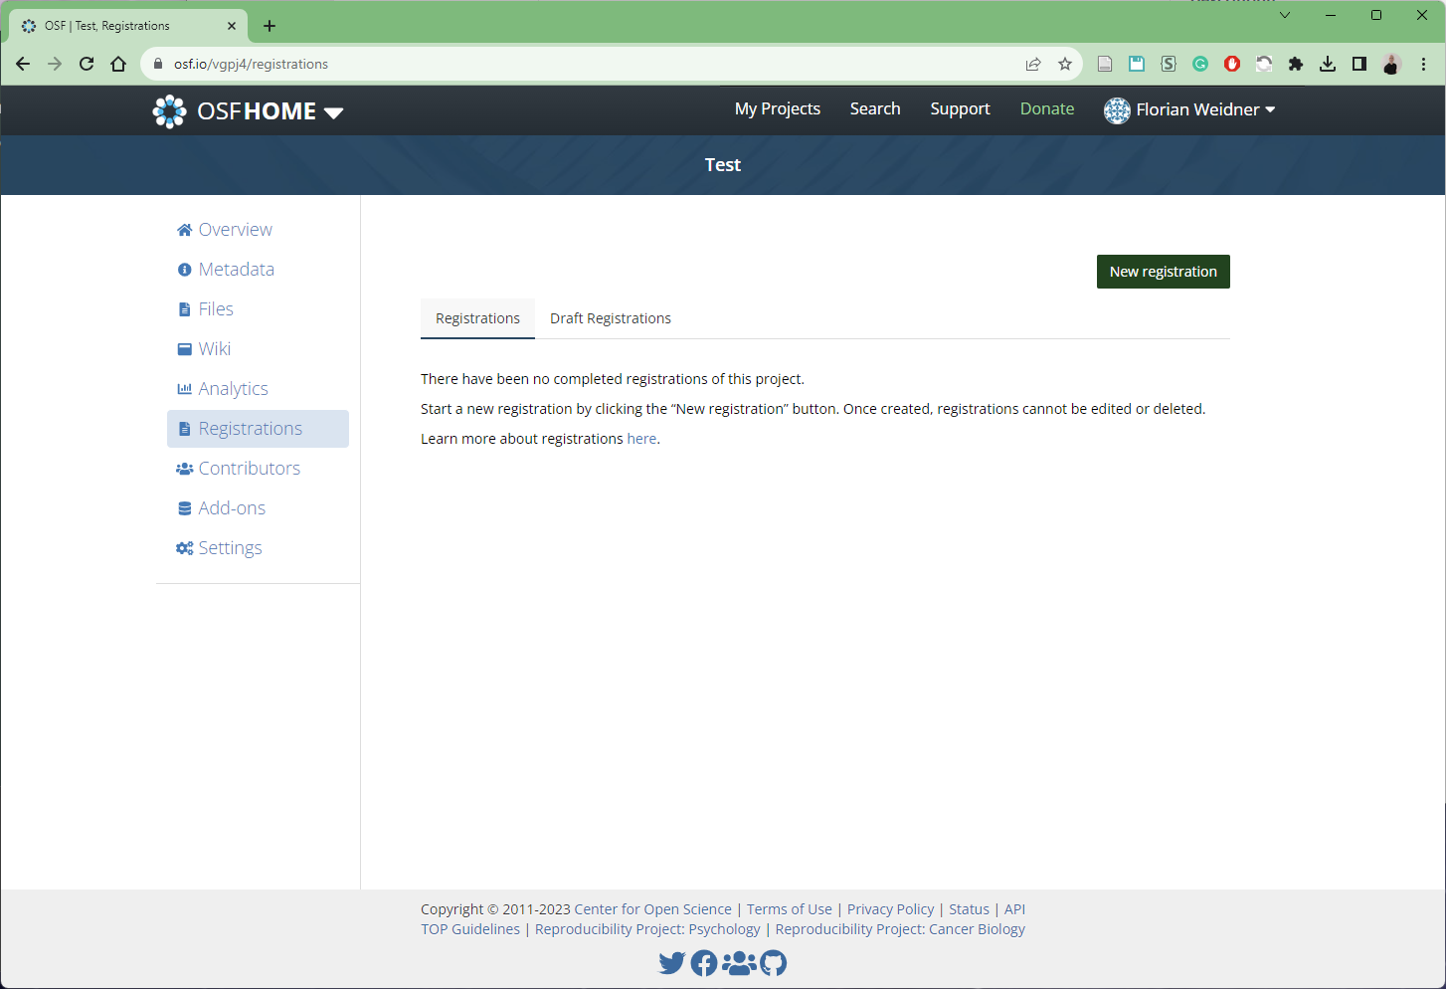
OSF Workflow
Create new registration

Slide 13
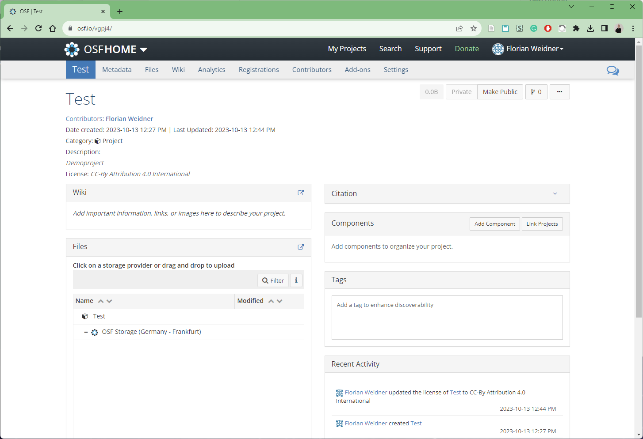
OSF Workflow
Creates new project

Slide 14
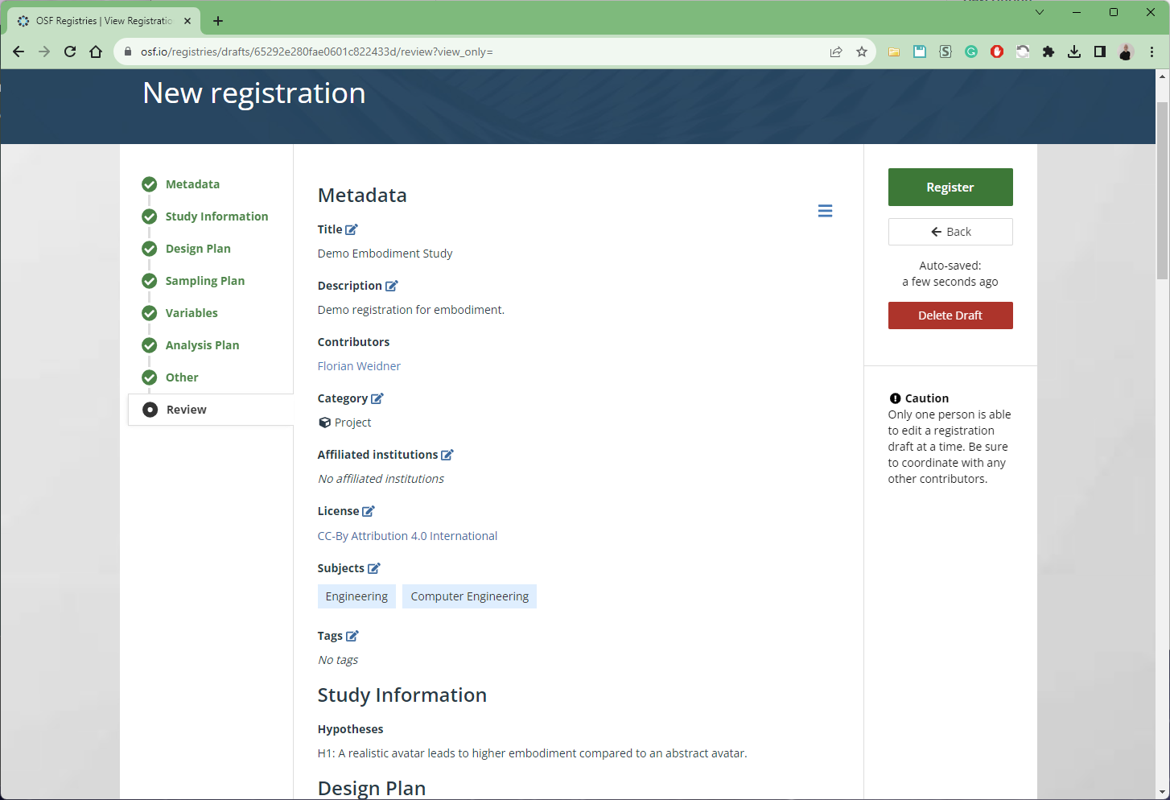
OSF Workflow
Fill out all info and register (updatable)

Slide 15
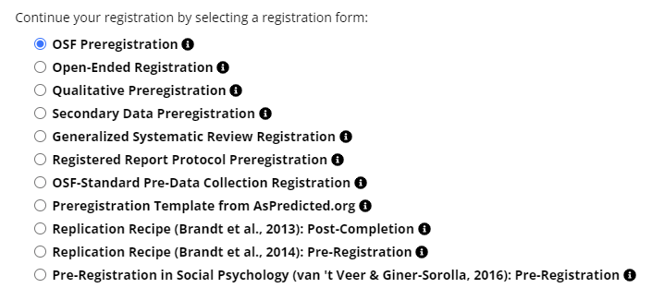
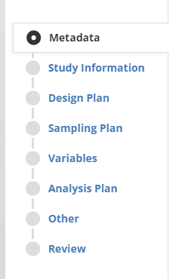
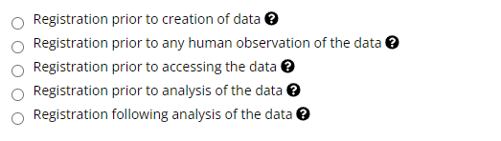
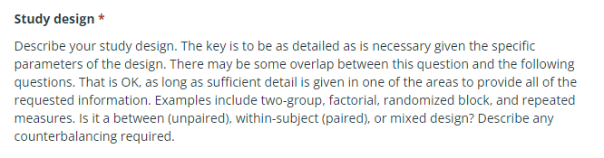
OSF Workflow: Pre-registration
General information
Hypothesis
Design plan
Study type
Blinding
Study design
Randomization
Sampling plan
Existing data*
Explanation of existing data
Data collection procedure*
Sample size* + rationale + stopping rule
Variables
Dependent variables
Independent variables*
Indexing?
Analysis plan
Statistical models*
Transformations
Inference criteria (e.g., p-value)
Data exclusion
Missing data
Exploratory analysis

Slide 16
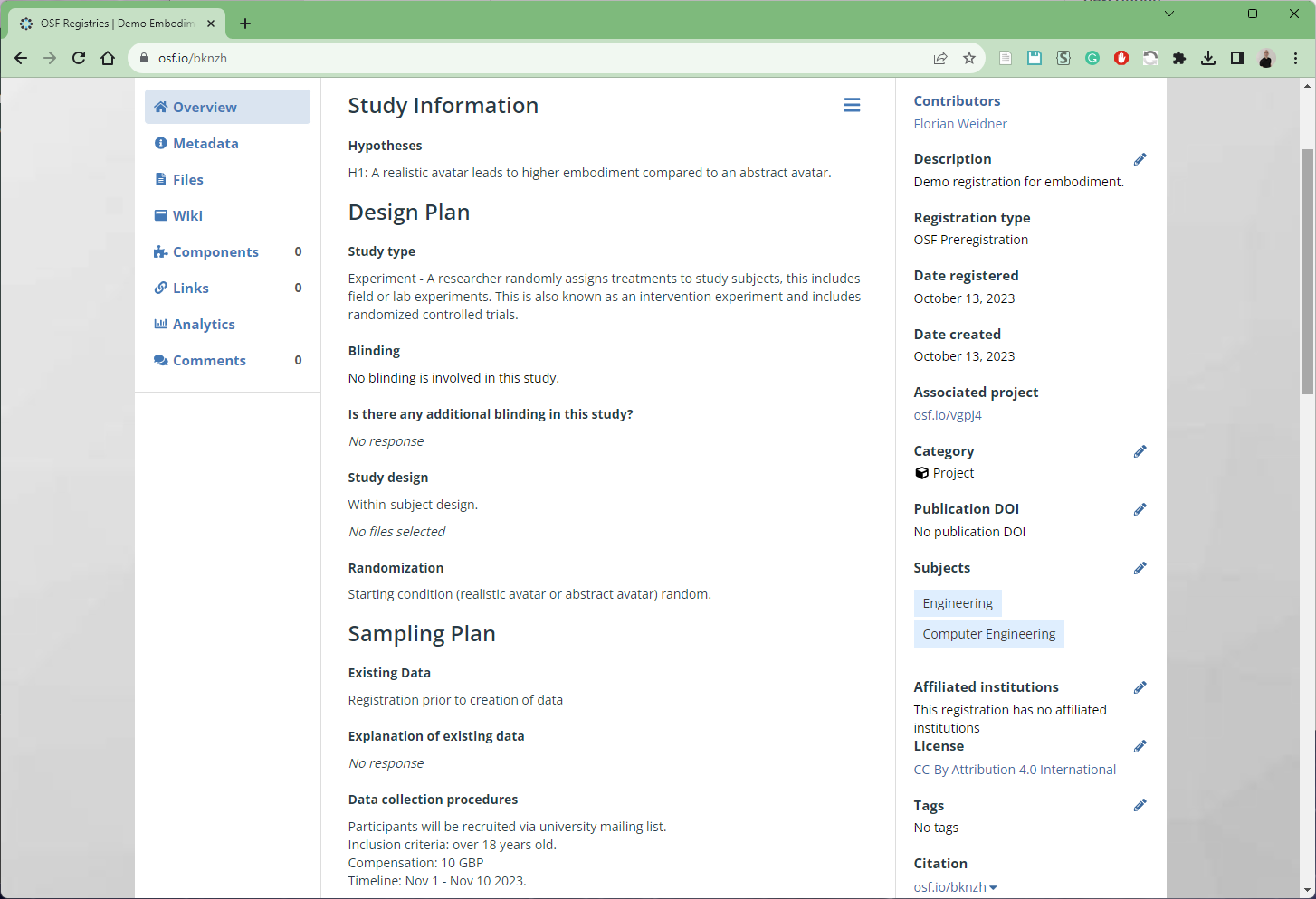
OSF Workflow
https://tinyurl.com/worxr1
Anonymous link to registration possible: https://osf.io/bknzh/?view_only=bda587ab846f416482460924e019bf91

Slide 17
… do study …

Slide 18
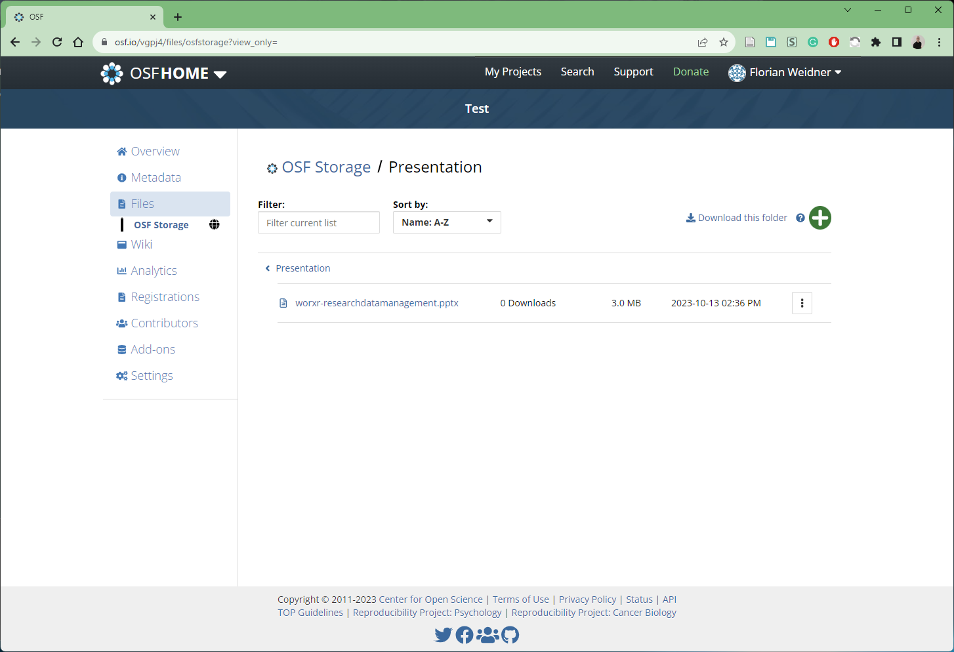
OSF Workflow
Add some data.

Slide 19
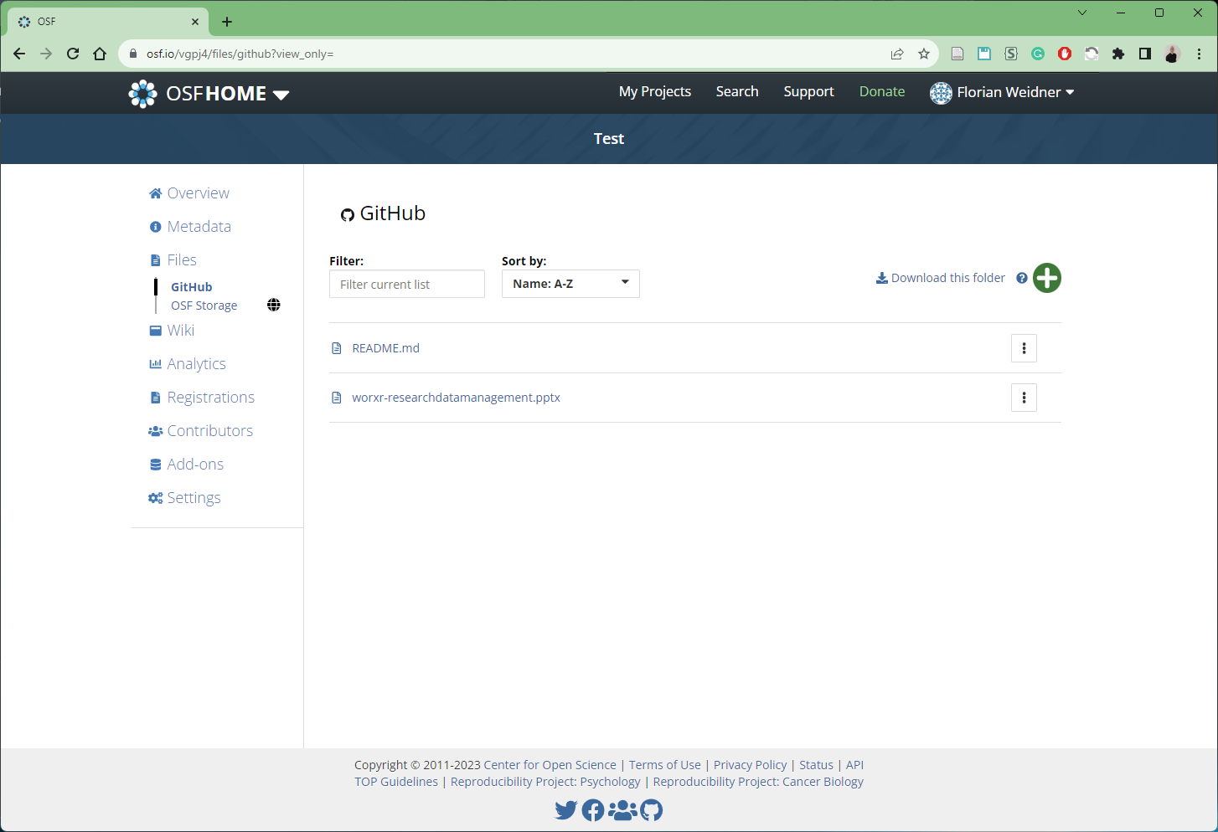
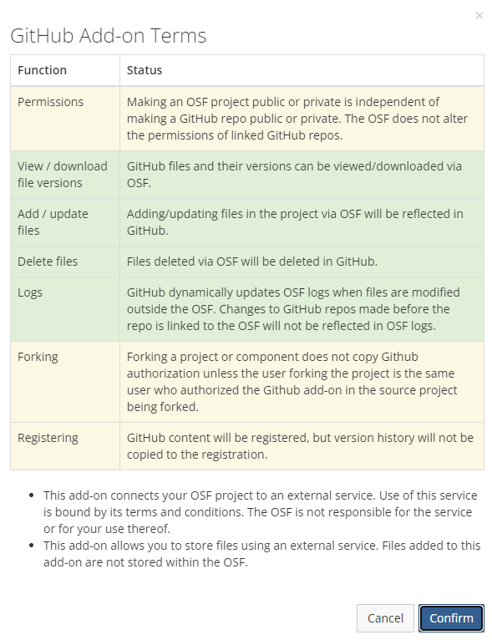
OSF Workflow
Github + OSF
No file mirror!

Slide 20
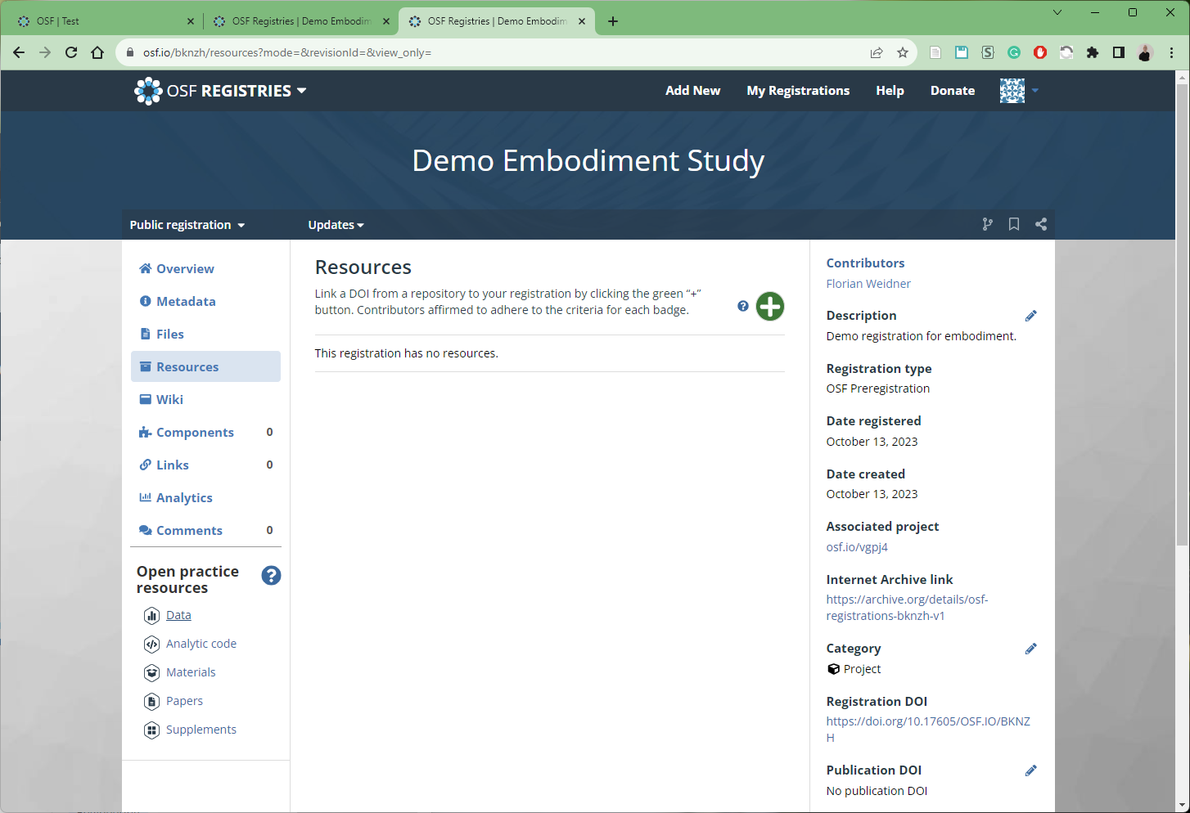
OSF Workflow
Link project to registration via project DOI.

Slide 21
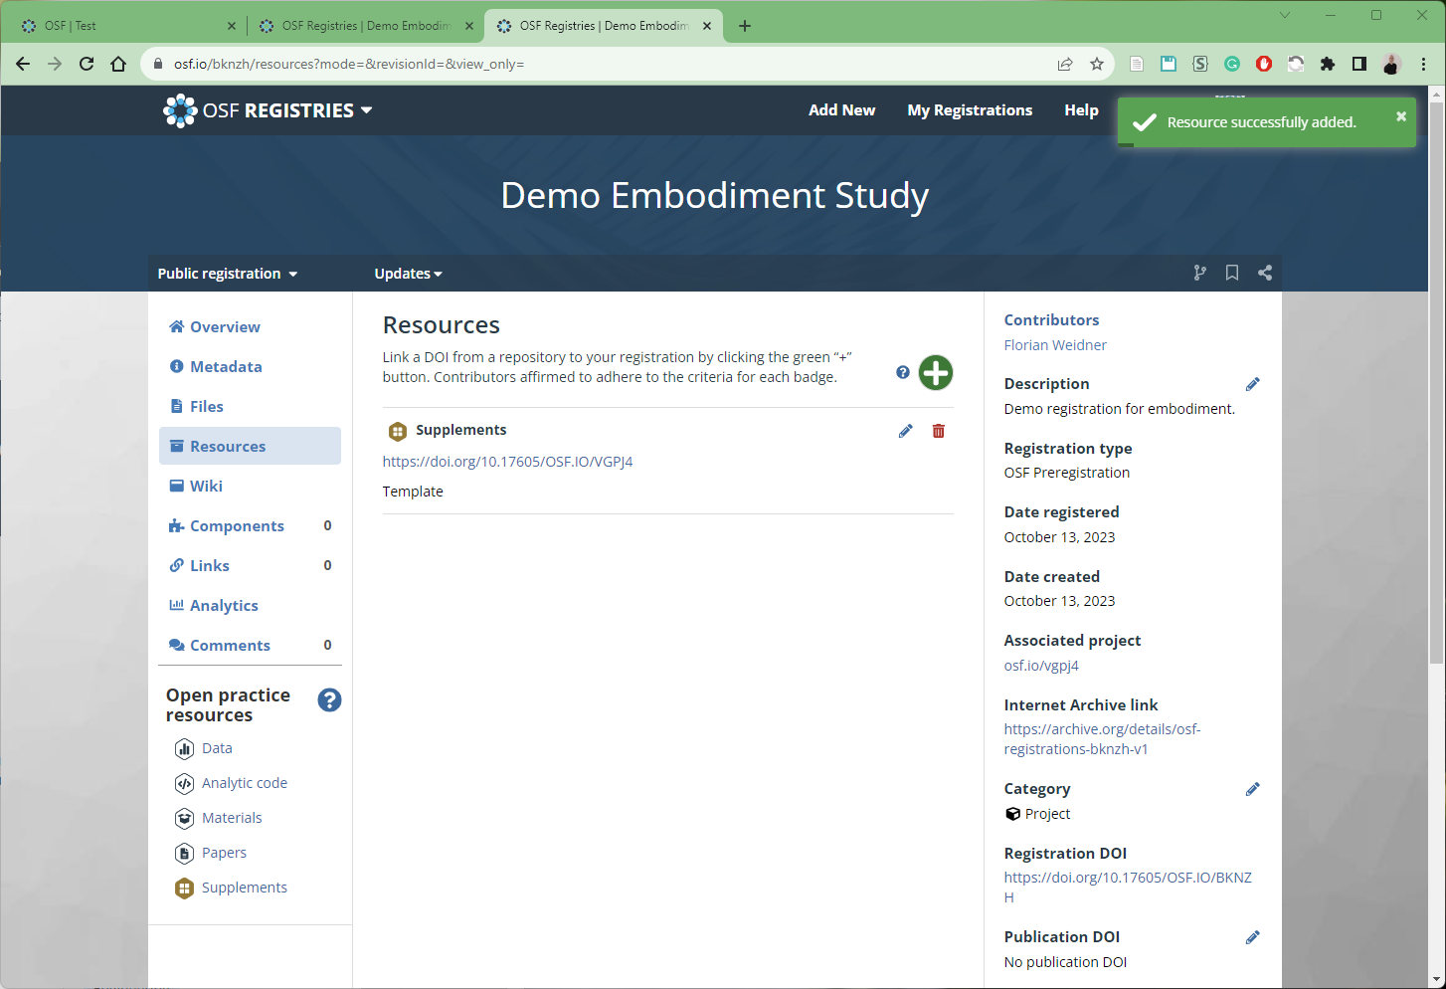
OSF Workflow
Link project to registration via project DOI ☺
[1] F. Weidner, “Demo Embodiment Study”, 13-Oct-2023. [Online]. Available: https://osf.io/bknzh.

Slide 22
OSF comments
Free
Foundation well-funded (long-term perspective)
Preregistration
Anonymous links
Versioning possible
50GB
Links to github release → no file mirror.
Covers research lifecycle
https://github.com/eblondel/zen4R

Slide 23
Tl;dr: OSF
Create and fill out pre-registration.
Do study.
Create project and upload data, analytics code, materials, papers, and supplemental.
Create view-only links (private or not)
Add them to manuscript.
Be happy ☺

Slide 24
IEEE DataPort
All about datasets.

Slide 25
IEEE DataPort comments
Free only for subscribers
Up to 2TB or 10TB
Open access for 1.950 USD (sometimes discounts)
Long-term via IEEE
Linked to IEEE account
No preregistration
DOI
(designed for competitions)

Slide 26
Data documentation

Slide 27
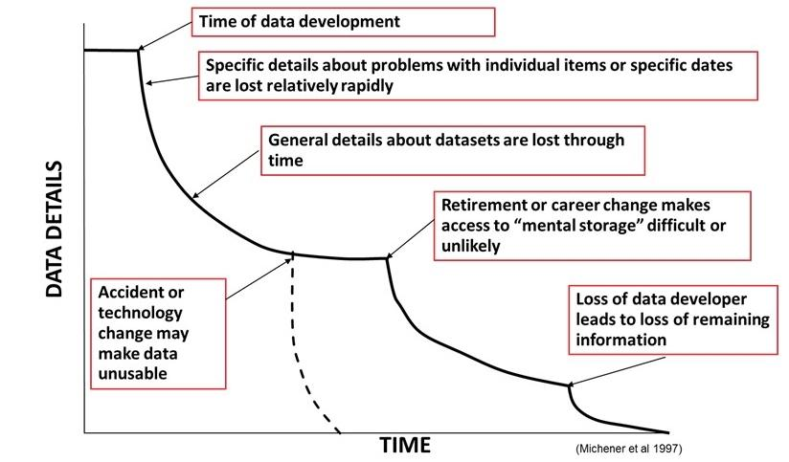
How do we document it?

Slide 28
How do we document it?
README files
Version control
Codebook
Documented code
Jupyter Notebooks
Workflow screenshots
…

Slide 29
Summary

Slide 30
All together?
Soft requirement / extra recognition?
Executable + setup instructions
Study protocol and self-defined questions
Raw data + scripts to calculate results in paper
Video
Preprint
OSF, Zenodo, IEEE DataPort?
OSF: allrounder, free, pre-registration, 50GB
Zenodo: easy via github, free, 50GB, no pre-registration
DataPort: large storage, paid

Slide 31
Replicability and data/algorithm storage and availability
3rd Workshop on Replication in Extended Reality (WoRXR)
Florian Weidner, Lancaster University
Thank you! Questions?

Slide 32
Some resources
https://www.acm.org/publications/policies/digital-artifacts
https://journals.ieeeauthorcenter.ieee.org/create-your-ieee-journal-article/research-reproducibility/

Slide 33
FAIR data
https://en.wikipedia.org/wiki/FAIR_data
https://www.go-fair.org/fair-principles/
Fair != open

